Slide 1

Algorithms Design and Analysis- 2
Greedy Algorithms
Mayada Hadhoud
Computer Engineering Department
Cairo University
Fall 2016

Slide 2
Agenda
Introduction
Applications of the Greedy Strategy
Activity selection problem
Single source shortest path algorithm
Knapsack problem
Traveling salesman problem

Slide 3
Introduction
Used for optimization problems
Basic idea: When we have a choice to make, make the one that looks best right now. Make a locally optimal choice in hope of getting a globally optimal solution.
Greedy algorithms don’t always yield an optimal solution. But sometimes they do.
For some problems, yields an optimal solution for every instance. For most, does not but can be useful for fast approximations.

Slide 4
Applications of the Greedy Strategy
Optimal solutions:
change making for “normal” coin denominations
minimum spanning tree (MST)
single-source shortest paths
simple scheduling problems
Huffman codes
Approximations:
traveling salesman problem (TSP)
knapsack problem
other combinatorial optimization problems

Slide 5
Activity Selection Problem
n activities require exclusive use of a common resource.
For example, scheduling the use of a classroom.
Set of activities S = {a1, . . . , an}.
ai needs resource during period [si , fi ), which is a half-open interval, where si = start time and fi = fnish time.
Goal: Select the largest possible set of non overlapping (mutually compatible) activities.

Slide 6
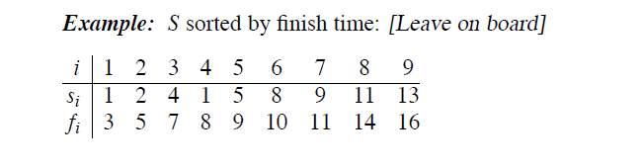
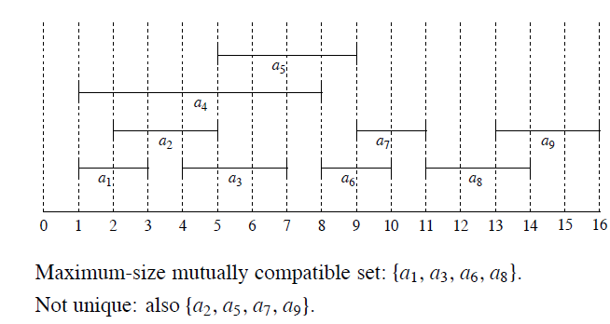
Activity Selection Problem

Slide 7
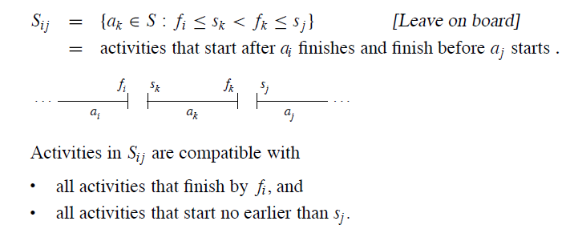
Activity Selection Problem
Optimal substructure of activity selection problem:

Slide 8
Activity Selection Problem
Optimal substructure of activity selection problem:
Assume that activities are sorted by increasing finish time: f0<= f1<= f2<=f2…..<=fn
Suppose that a solution to Sij includes ak . Have 2 subproblems:
Sik (start after ai finishes, finish before ak starts)
Skj (start after ak finishes, finish before aj starts)
Solution to S_{ij}iis (solution to S_{ik} ) ∪ {ak} ∪ (solution to S_{kj}).
Since a_{k} is in neither subproblem, and the subproblems are disjoint,
|solution to S| = |solution to S_{ik}| + 1 + |solution to S_{kj}i| .

Slide 9
Activity Selection Problem
Optimal substructure of activity selection problem:
If an optimal solution to Sij includes ak , then the solutions to Sik and Skj used within this solution must be optimal as well.
Let Aij = optimal solution to Sij .
So Aij = Aik ∪ {ak} ∪ Akj.

Slide 10

Activity Selection Problem
Recursive solution:
c[i, j ] = size of maximum-size subset of mutually compatible activities in Si j .
i ≥ j ⇒ Si j = ∅⇒c[i, j ] = 0.
If Si j = ∅, suppose we know that ak is in the subset. Then
c[i, j ] = c[i, k] + 1 + c[k, j ] .
But of course we don’t know which k to use, and so

Slide 11
Activity Selection Problem
Making the greedy choice
Select an activity to add to our optimal solution without solving all the subproblems first .
In our problem the greedy choice is “choose an activity that leaves the resource available for as many other activates as possible – choose the activity with the earliest finish time”

Slide 12
Activity Selection Problem
Making the greedy choice
Given that the activities are sorted in increasing order by finish time
The greedy choice is a1
After the greedy choice we have only 1 subproblem to solve : finding the activities that starts after a1 finishes

Slide 13
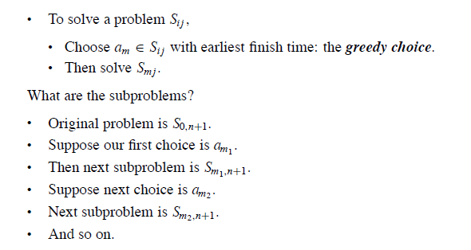
Activity Selection Problem

Slide 14
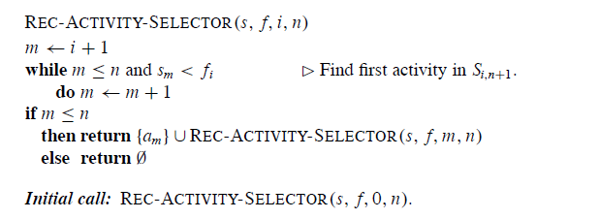
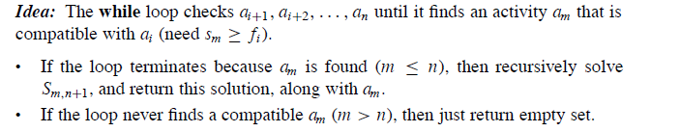
Activity Selection Problem
A recursive greedy algorithm

Slide 15
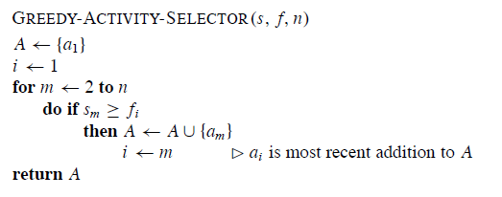

Activity Selection Problem
An iterative greedy algorithm

Slide 16
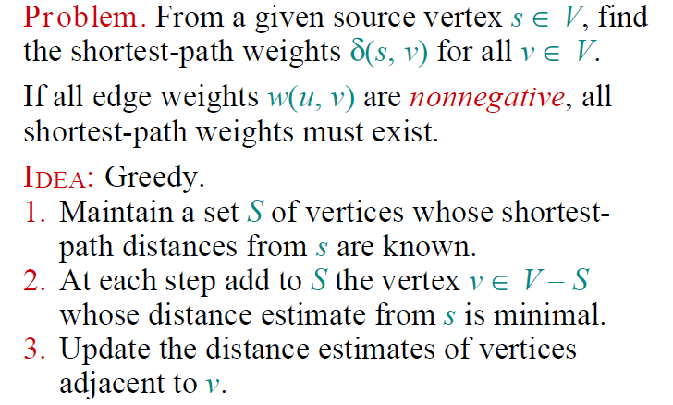
Single-Source shortest paths

Slide 17
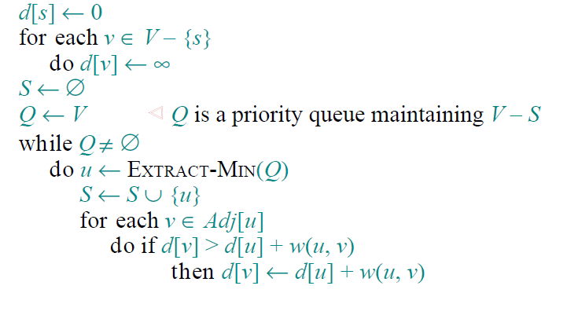
Dijkestra’s Algorithm

Slide 18
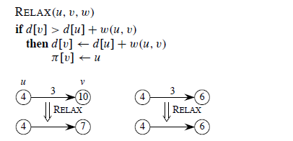
Dijkestra’s Algorithm
Edge relaxation
Estimate the shortest path estimate for vertex (v) by going through vertex(u) and taking (u,v).

Slide 19
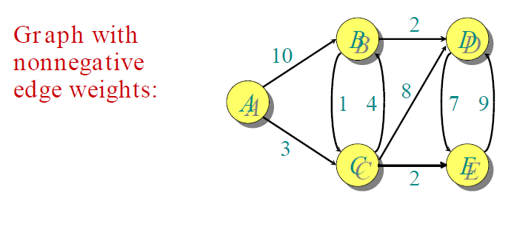
Example of Dijkestra’s Algorithm

Slide 20
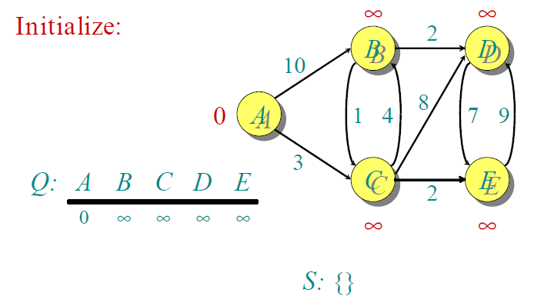
Example of Dijkestra’s Algorithm

Slide 21
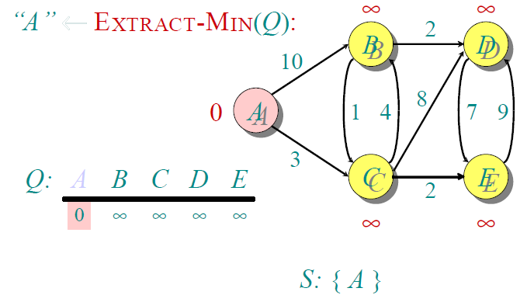
Example of Dijkestra’s Algorithm

Slide 22
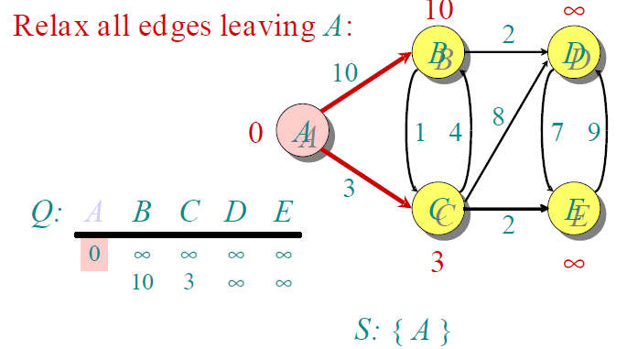
Example of Dijkestra’s Algorithm

Slide 23
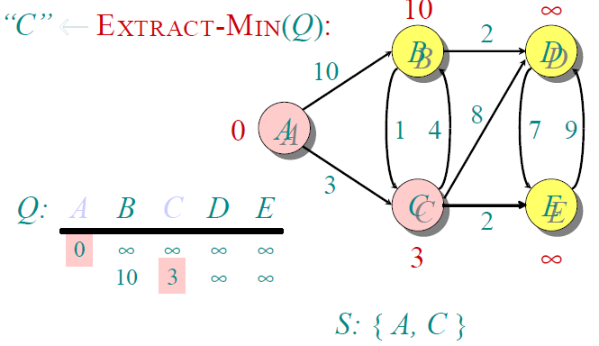
Example of Dijkestra’s Algorithm

Slide 24
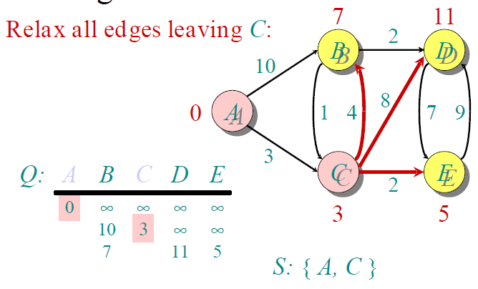
Example of Dijkestra’s Algorithm

Slide 25
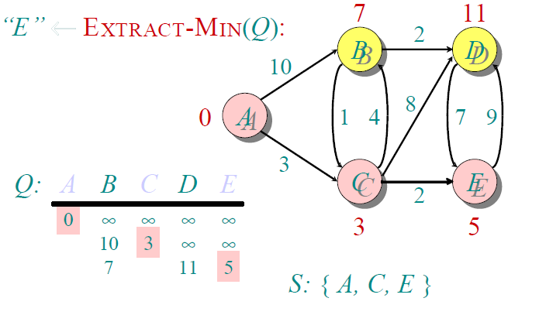
Example of Dijkestra’s Algorithm

Slide 26
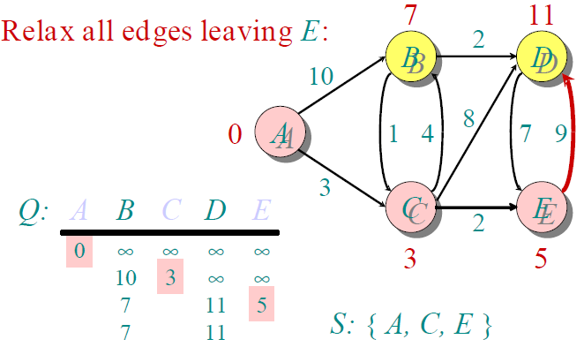
Example of Dijkestra’s Algorithm

Slide 27
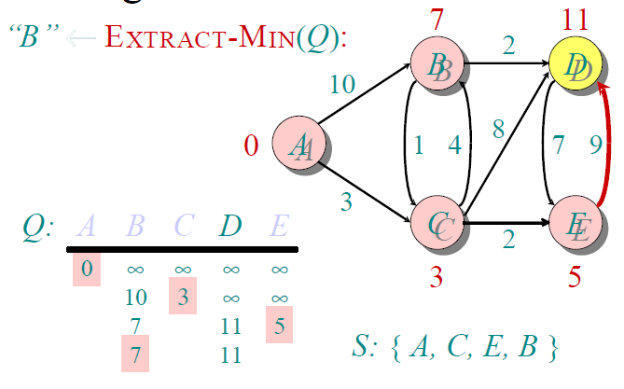
Example of Dijkestra’s Algorithm

Slide 28
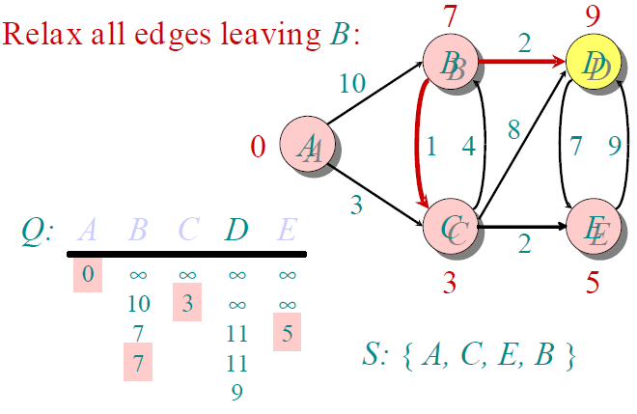
Example of Dijkestra’s Algorithm

Slide 29
Notes on Dijkstra’s algorithm
Doesn’t work for graphs with negative weights
Applicable to both undirected and directed graphs
Efficiency (Prove)
O(|V|²) for graphs represented by weight matrix and array implementation of priority queue
O(|E|log|V|) for graphs represented by adj. lists and min-heap implementation of priority queue

Slide 30
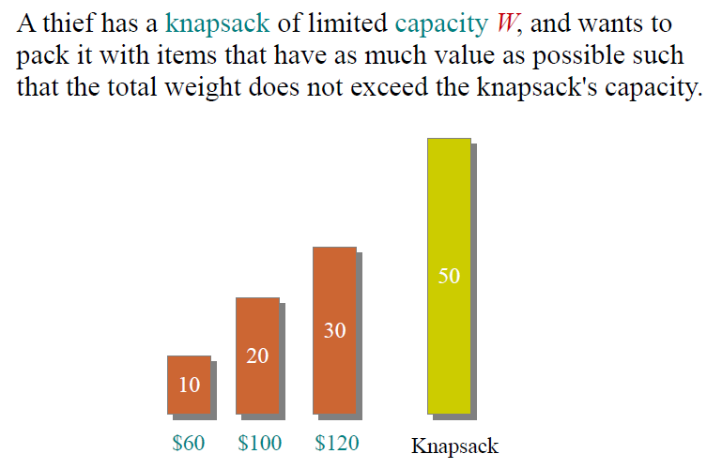
Knapsack Problem

Slide 31
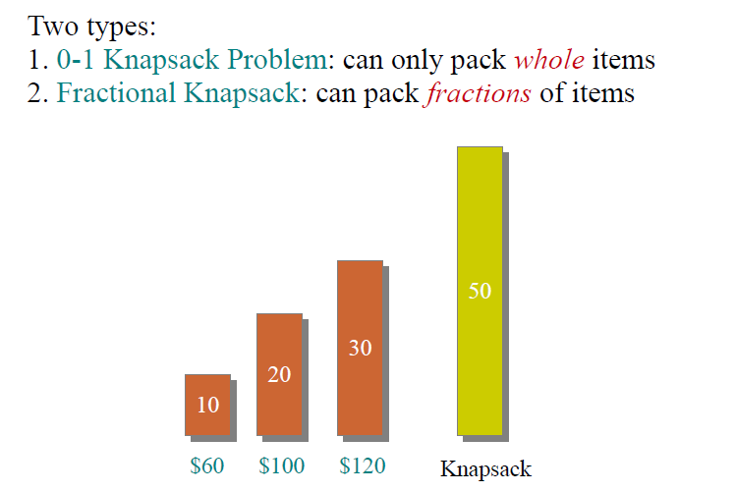
Knapsack Problem

Slide 32
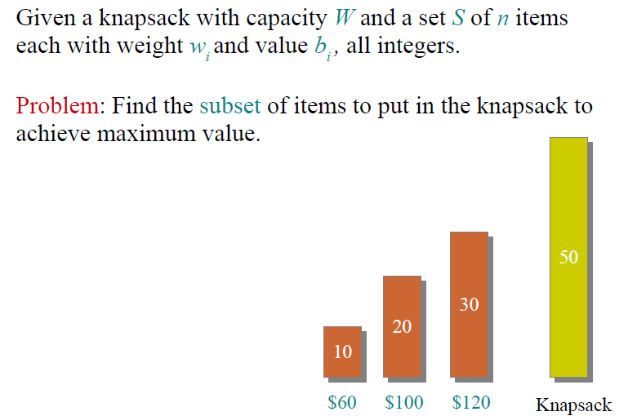
Knapsack Problem

Slide 33
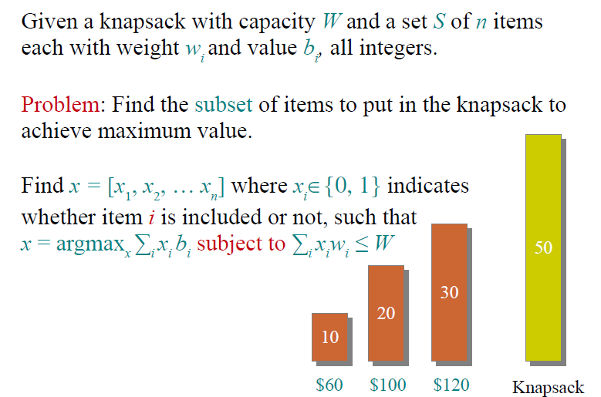
Knapsack Problem

Slide 34
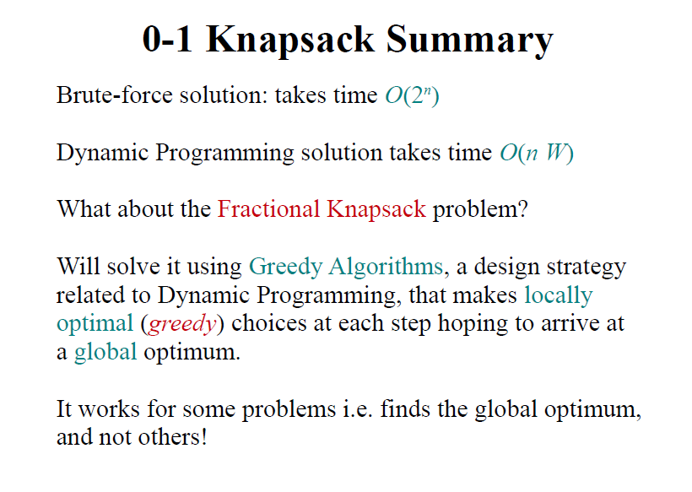

Slide 35
Greedy Choices
Select always the most valuable items
Select always the lighter items
Select always the object with highest ratio value/weight

Slide 36
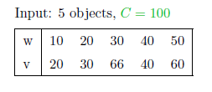
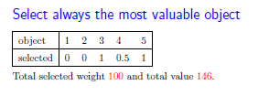
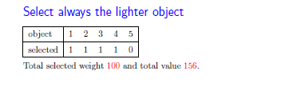
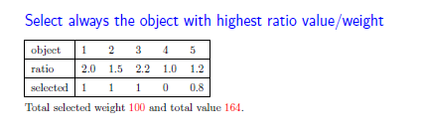

Slide 37
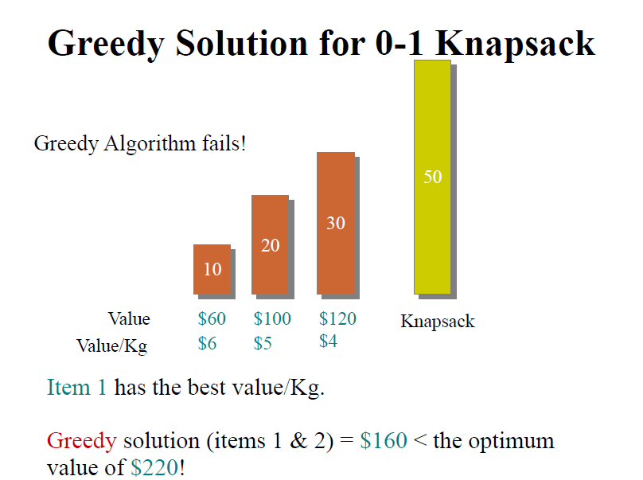

Slide 38
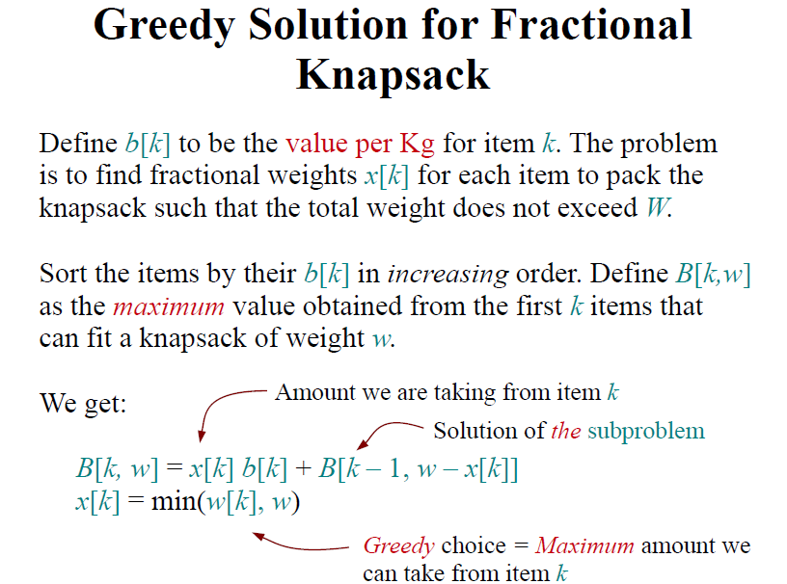

Slide 39
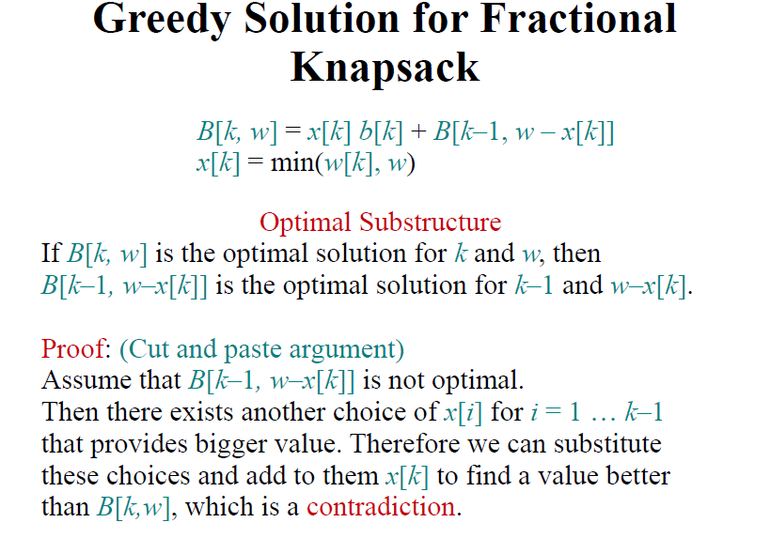

Slide 40
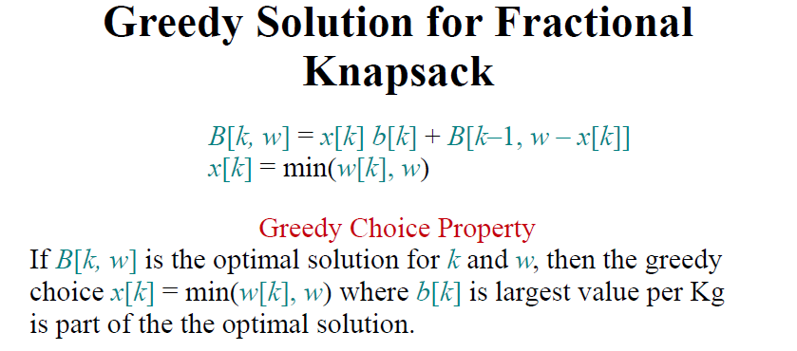

Slide 41
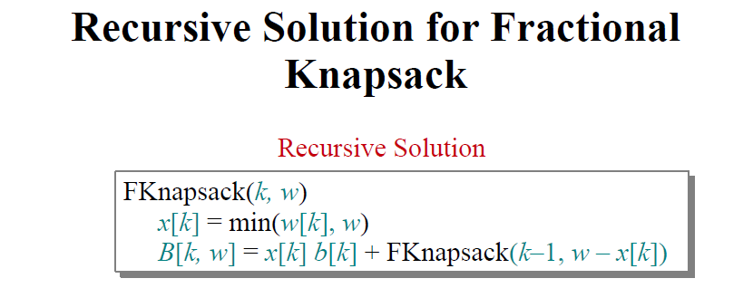
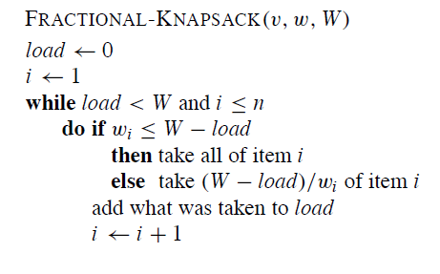
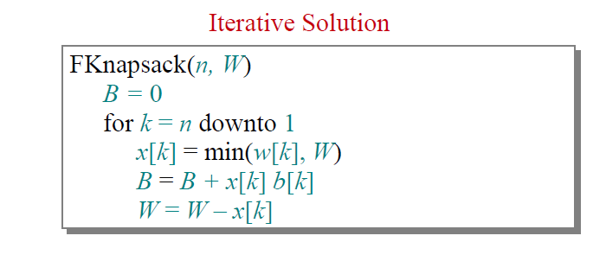


Slide 42
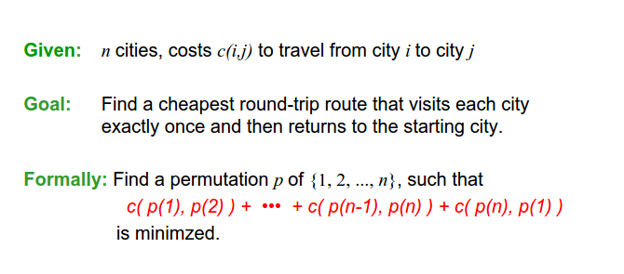
Traveling salesman problem

Slide 43
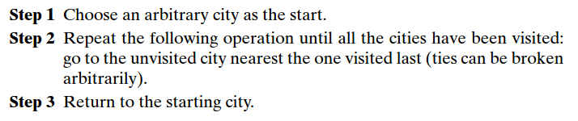
Traveling salesman problem
Nearest Neighbor Algorithm
Greedy choice : always go next to the nearest unvisited city.

Slide 44
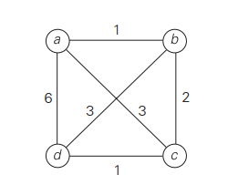
Traveling salesman problem
Nearest Neighbor Algorithm
Example: Start at city (a)
The tour a-b-c-d-a (length = 10)
The optimal solution is a-b-d-c-a (length =8)

Slide 45
Quiz
Consider the following version of the 0/1 knapsack problem. Given a set of n objects with weights w1>w2>w3>….>wn, and profits p1<p2<p3<…..<pn, find a subset of objects such that the total weight is bounded by a given capacity W and the total profit is maximized. Describe the best greedy algorithm you can for solving this problem. Does you algorithm result in an optimal solution? Justify your answer.

